Slide 1
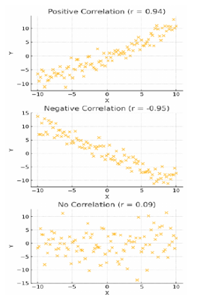
CORRELATION ANALYSIS
We often want to know:
  How do two variables change together?
  Example: If study hours increase, do exam scores also increase?

Slide 2
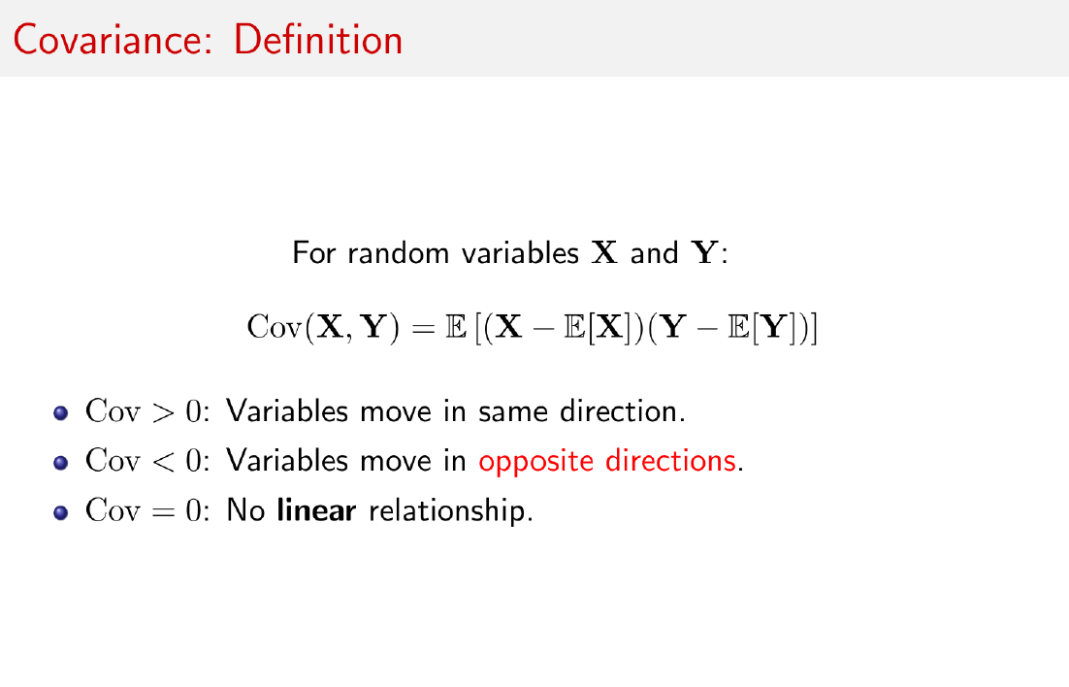


Slide 3
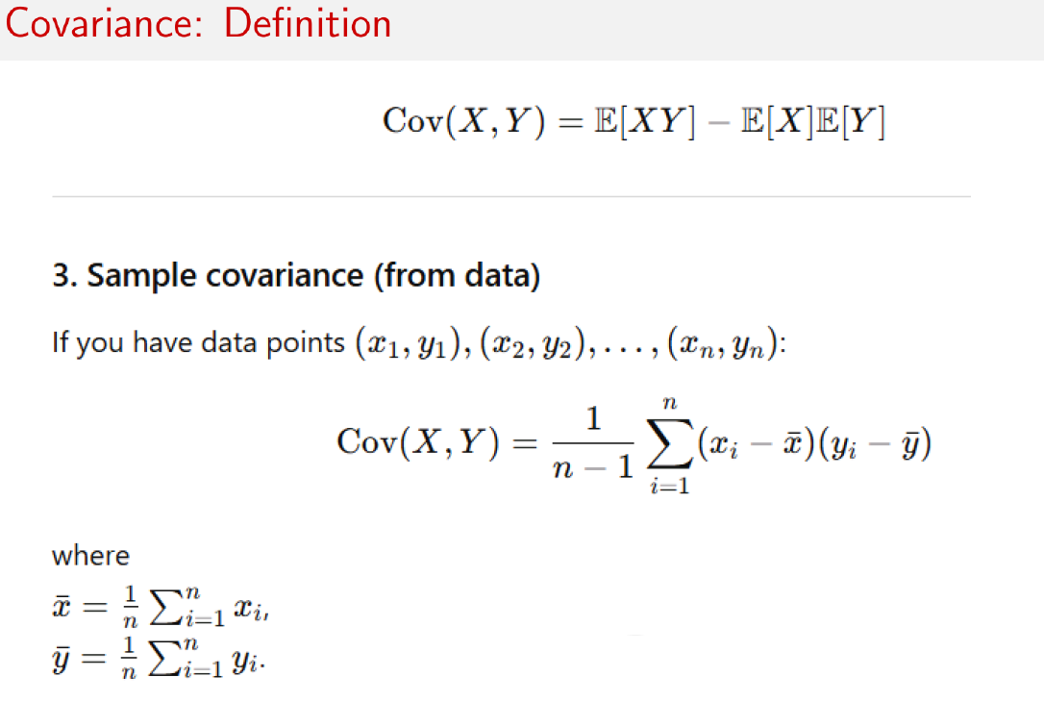

Slide 4
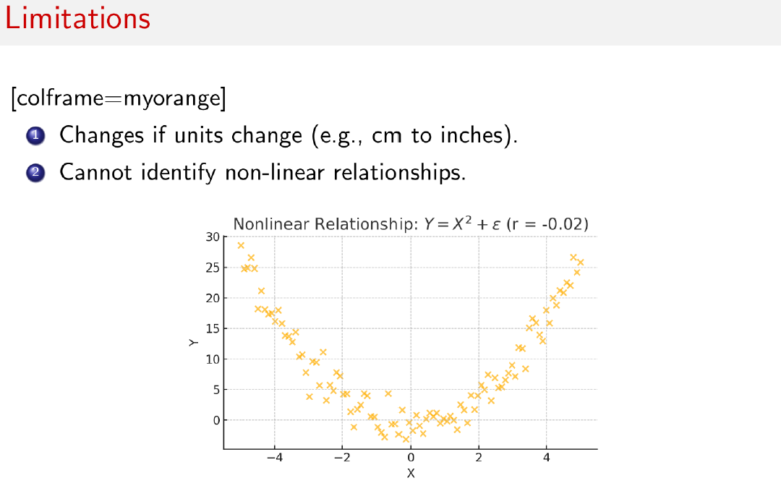

Slide 5
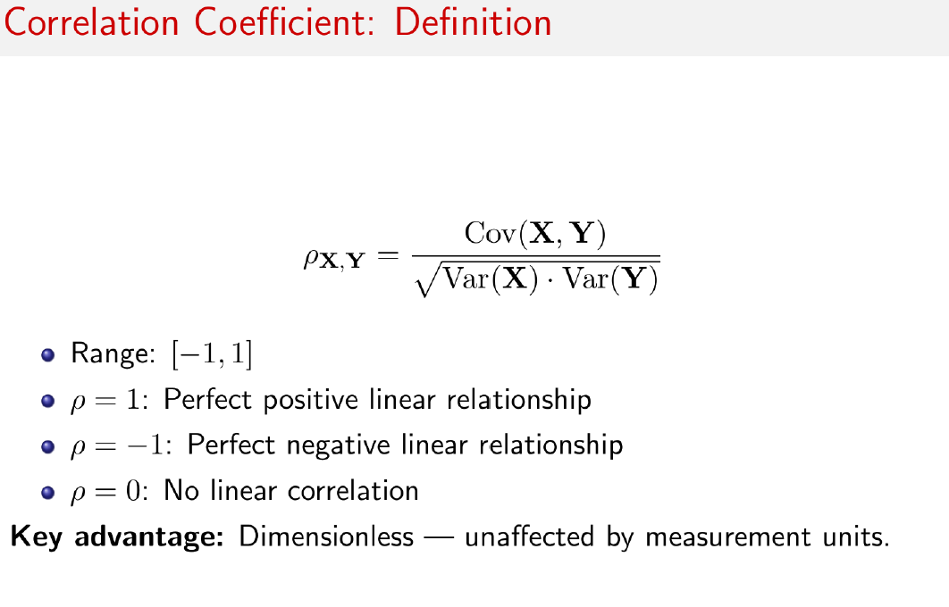

Slide 6
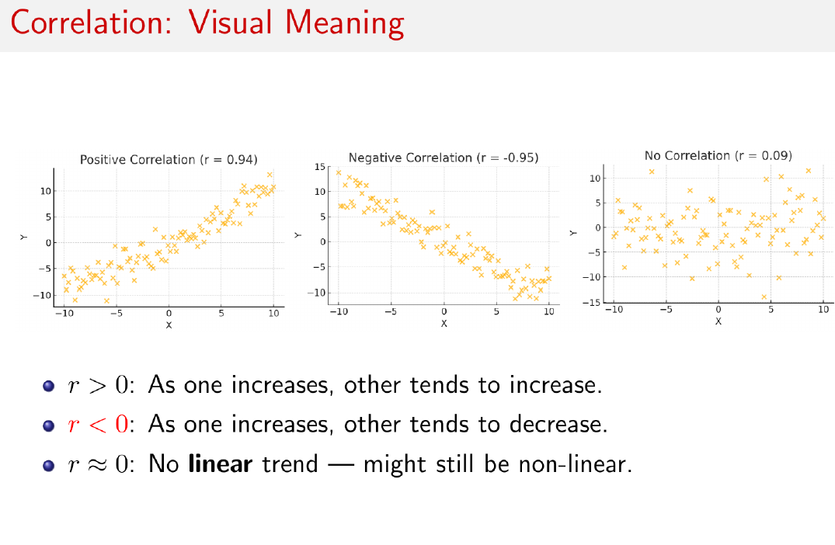

Slide 7
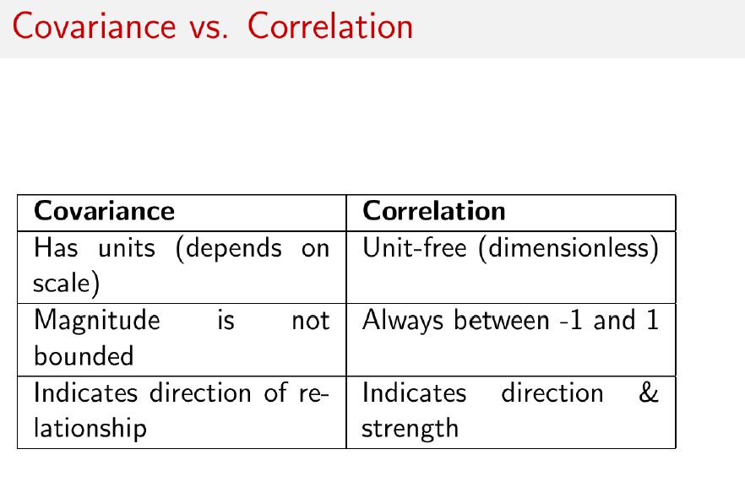

Slide 8
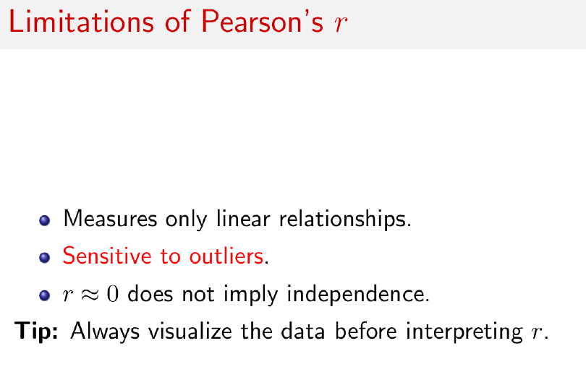

Slide 9
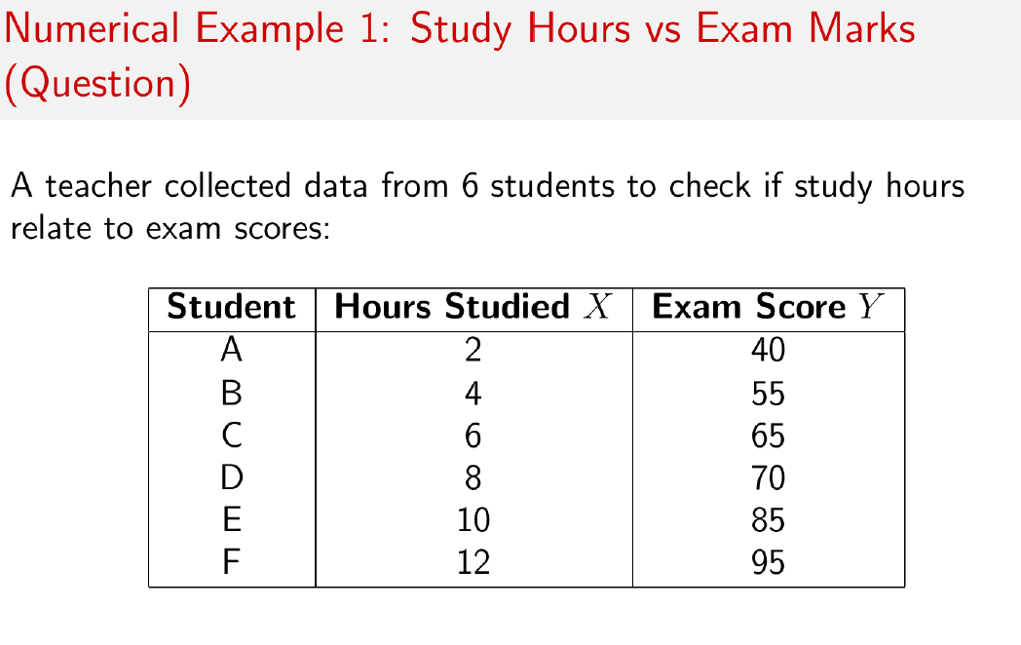

Slide 10

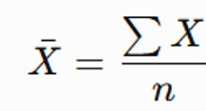
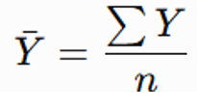
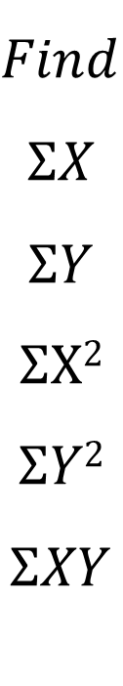
$$Find$$
$$ΣX$$
$$ΣY$$
$$ΣX2$$
$$ΣY2$$
$$ΣXY$$

Slide 11
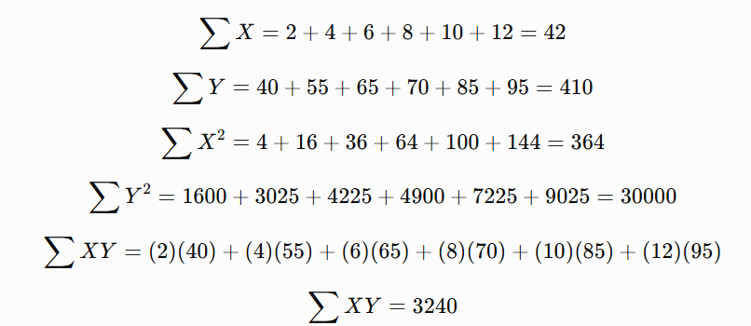

Slide 12
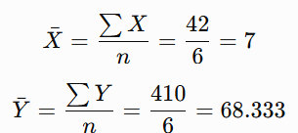
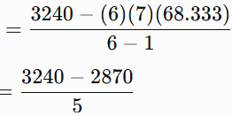


Slide 13
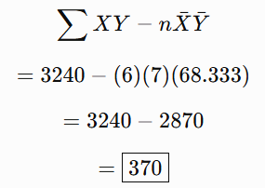
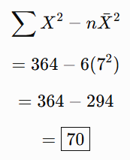
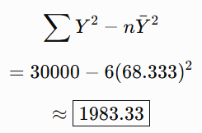

Slide 14
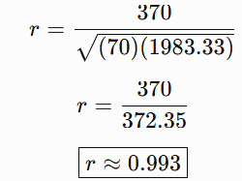
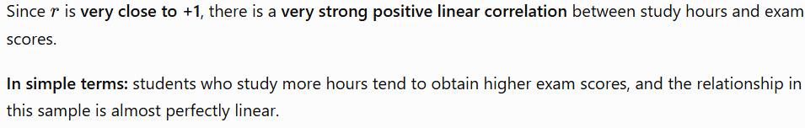

Slide 15
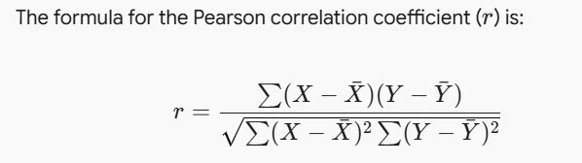
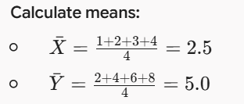
Find the correlation coefficient between X=[1,2,3,4] and Y=[2,4,6,8]

Slide 16
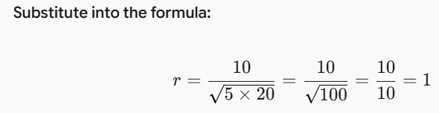
X | Y | X−Xˉ | Y−Yˉ | (X−Xˉ)2 | (Y−Yˉ)2 | (X−Xˉ)(Y−Yˉ)
1 | 2 | -1.5 | -3.0 | 2.25 | 9.0 | 4.5
2 | 4 | -0.5 | -1.0 | 0.25 | 1.0 | 0.5
3 | 6 | 0.5 | 1.0 | 0.25 | 1.0 | 0.5
4 | 8 | 1.5 | 3.0 | 2.25 | 9.0 | 4.5
Sum |  |  |  | 5.0 | 20.0 | 10.0

